Slide 1

A Data Analysis to Predict Customer Loyalty
By Ameen Abdelghani
December 2018

Slide 2

Problem Statement
Company :
Elo is one of Brazil’s top credit and debit card companies
Goal :
They’re offering a new perk to offer discounts on certain merchants
Wish to tailor the discounts to merchants users have actual demand for
Obstacle:
How to understand the differences in a customers purchasing pattern
Solution:
Elo’s desired first step is to accurately predict a customer’s loyalty based off their features

Slide 3

Why?
Will boost customer engagement with Elo
Give them incentives they care for
Can create more accurate ad campaigns
“ Get discounts to the shops YOU love! “ - Elo

Slide 4
Data
The data for this analysis is part of a current Kaggle competition
The data of use is the training, test, historical transaction, and new merchants data
CSV format
200,000 observations approximately
Majority of features are anonymous

Slide 5
Data
Columns on training data
Feature 1, 2 ,3
Card ID
First active month
Customer Loyalty
Historical / New Merchants data
Authorized Flag (Yes or No)
Month Lag (how long before they visited the shop)
Purchase Amount
City ID / Merchant ID
Other anonymous features

Slide 6
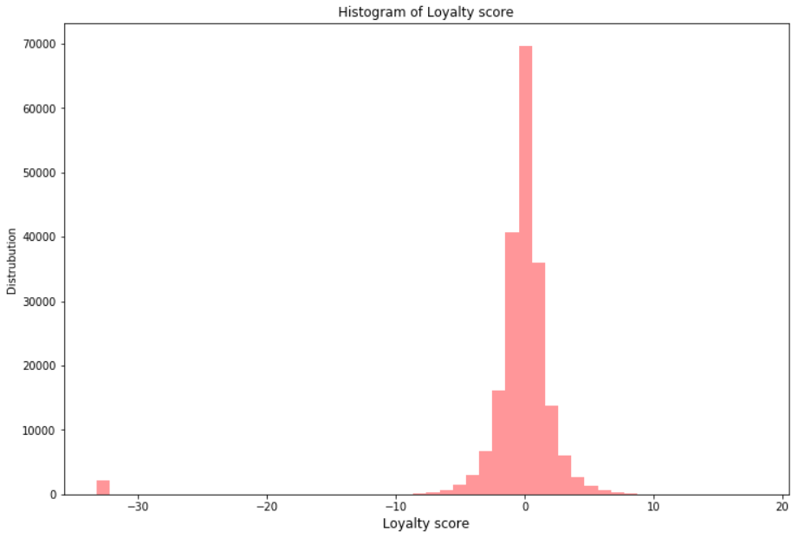
EDA / Data Wrangling
Converted first active month to datetime
Created elapsed feature time from latest date in data
Observed Loyalty Score range
Notes:
Sharp outlier at -33, 1% of data

Slide 7
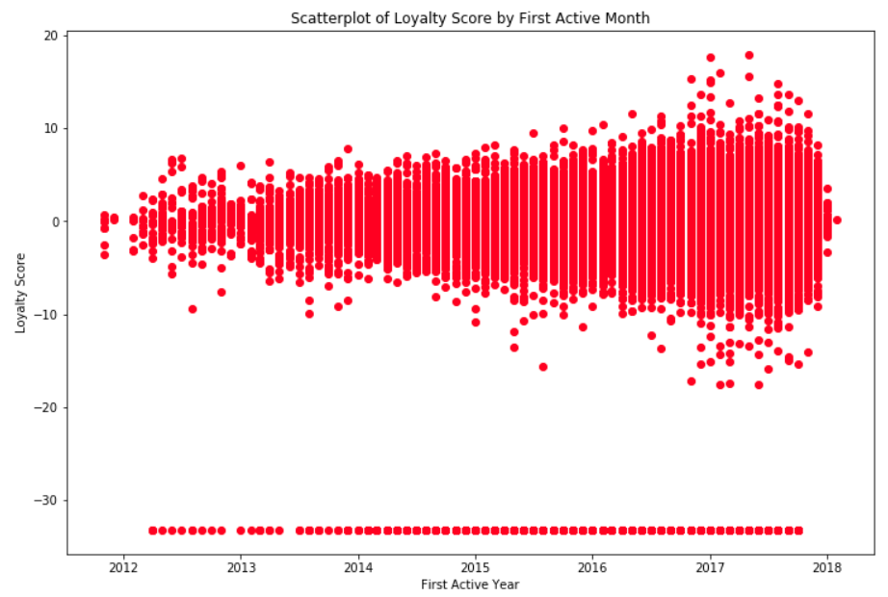
First Active Year vs Loyalty Score
Notes:
More spread the new the user is. -33 outlier remains constant

Slide 8
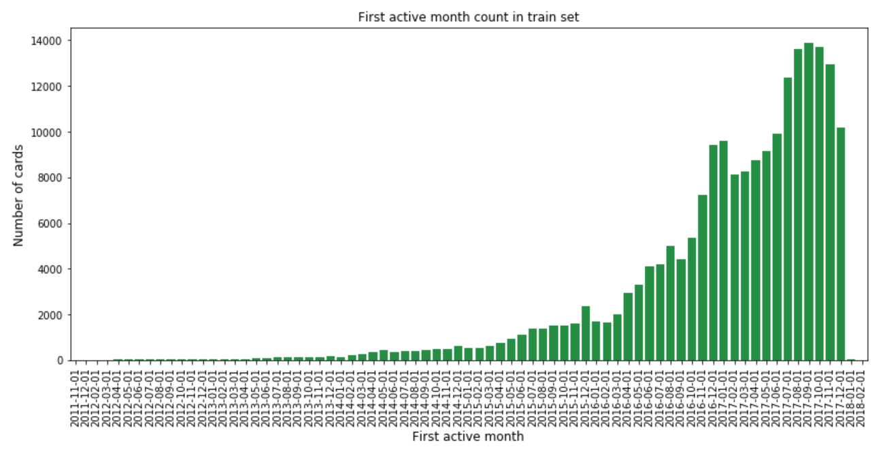
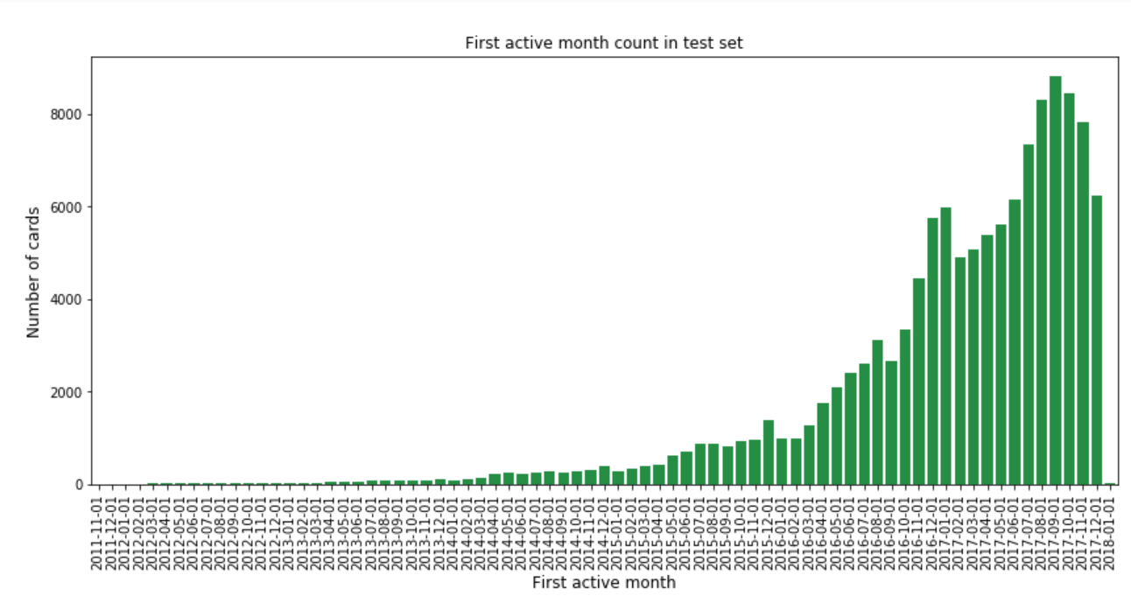
First active month difference between training and test data
Notes:
Nearly Identical

Slide 9
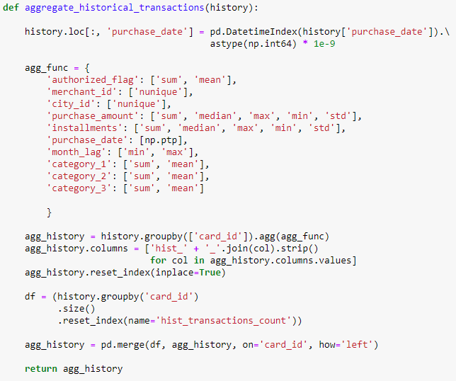
Feature Engineering
Performed a large groupby on Hist. Transactions to create new features based off each each customer
Notes:
Merged this with the training and test data based off card id

Slide 10
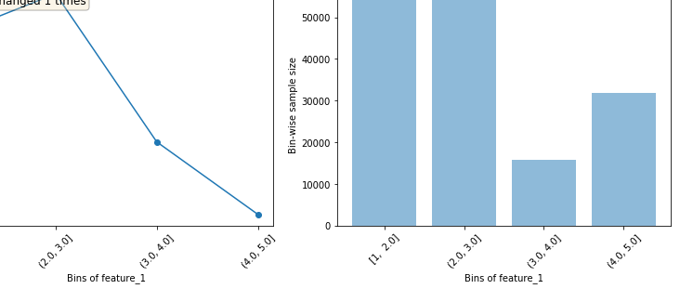
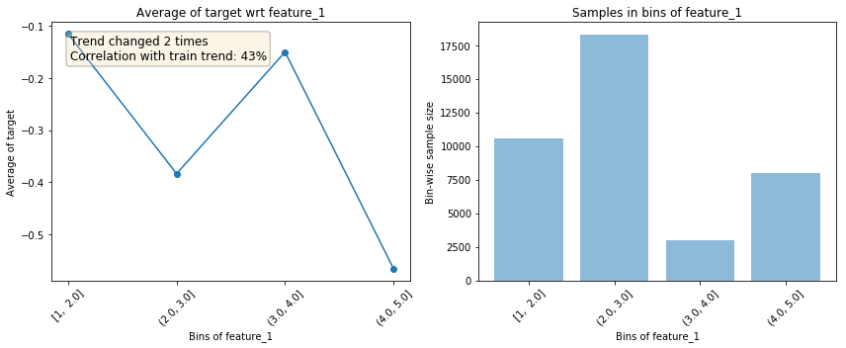
EDA
Utilized library called featexp
Bins all the feature and shows distribution
Trend correlation against the target variable
Compares trend on training vs validation set
Notes:
Can find odd values / data leakage as well

Slide 11
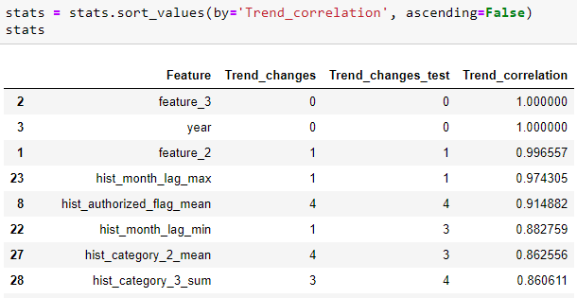
EDA / Feature Selection
Featexp module “stats” returns a pandas dataframe summarizing this info
Notes:
Limit the features in the model to the features with top trend correlation. Should reduce overfitting.

Slide 12
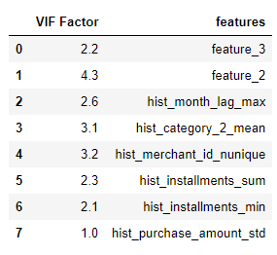
EDA / Feature Selection
Variance Inflation Factor
Statistical method to identify features causing multicollinearity
Reduced features with VIF of 5 or below
Notes:
Multicolinearity = which features are causing the same variation in the data
Will reduce overfitting and simplify the model

Slide 13
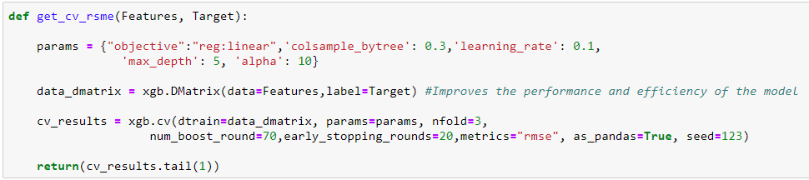
Model Prediction
Extreme Gradient Boosting chosen to predict customer loyalty
Metric for scoring: Root Mean Squared Error
Iterated over many varying attempts to achieve best score
Created function to easily run model with different training features as input
Notes:
XGB has become a gold standard in data science for its ease of use and consistent results. Linear Regression is not often used often anymore, except as a baseline model.
RMSE is the metric chosen by the kaggle competition by Elo

Slide 14
Results
Attempt 1
Limit the features to those with the top 15 trend correlation
Limit those remaining to those with low VIF scores
CV RMSE: 3.81
RMSE test: 3.91
Attempt 2
Use all applicable features available
CV RMSE: 3.75
RSME test: N/A (Model overfit due to too many features)
Attempt 3
Solely using features with VIF score of around 5 or below
CV RMSE : 3.80
RMSE Test : 3.91
Notes:
Intrinsic value = (# of pca features needed to approximate data)
Fit and transform the training and test data to 4 components (adding more components overfits the model)

Slide 15
Model Prediction
Attempt 4
Scale the data
Apply PCA
Determine Intrinsic Value . Result: 4
CV RMSE: 3.81
RSME Test: 4.22
Attempt 5
Simply tuning the model from attempt 2 by experimenting with the hyperparameters.
First attempt was using Gridsearchcv, but took too long.
Used trial and error instead
CV RMSE : 3.74
RMSE Test: N/A (Model overfit)
Notes:
The optimal hyperparamaters found in attempt 5 I used to modify the previous models
, Randomsearchcv could have also been an option.
Removing outlier had no effect on scoring.

Slide 16
Conclusion
RMSE acheived inapplicable to business case
Majority of scores between -1 and 1
More relevant data needed to predict customer loyalty
Wrong question / metric being sought by Elo
Their customer loyalty scoring currently not useful for customer segmentation
Goal not achieved but got to learn a lot :)

